Slide 1
Answering *your* questions

Slide 2
Surface tension

Slide 3
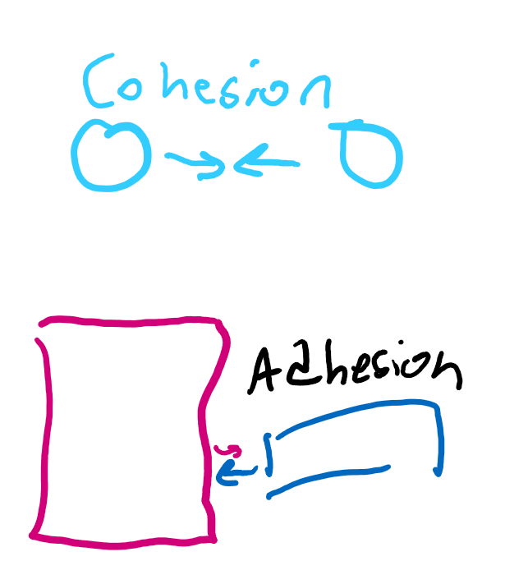
Why water is “sticky”
Sticks are stick-y
Water is sticky, meaning it likes to stick to itself and surfaces.
Sticking to itself is called “cohesion” and sticking to other things is called “adhesion.”
“Adhesive” tape is named that way because you can stick it on a different surface easily.

Slide 4
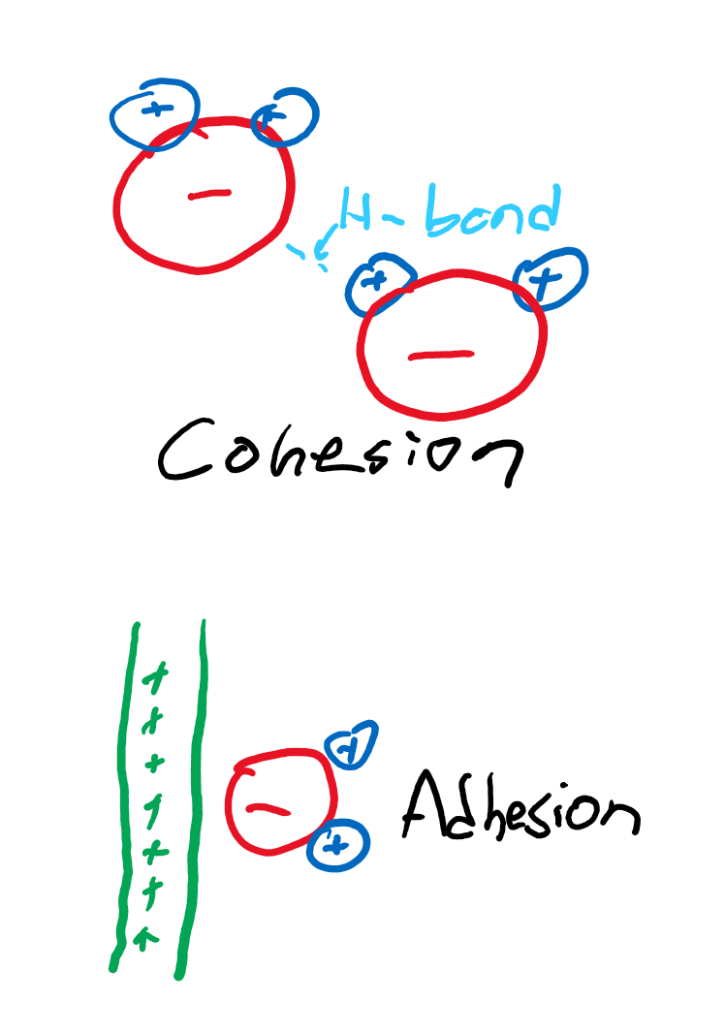
Water tension
Why is water cohesive? It has a positive and negative end. Positive ends on one water molecule want to stick to negative ends on another.
Why is water adhesive? Any object that stores a charge will cause one of the ends of water to stick there.

Slide 5
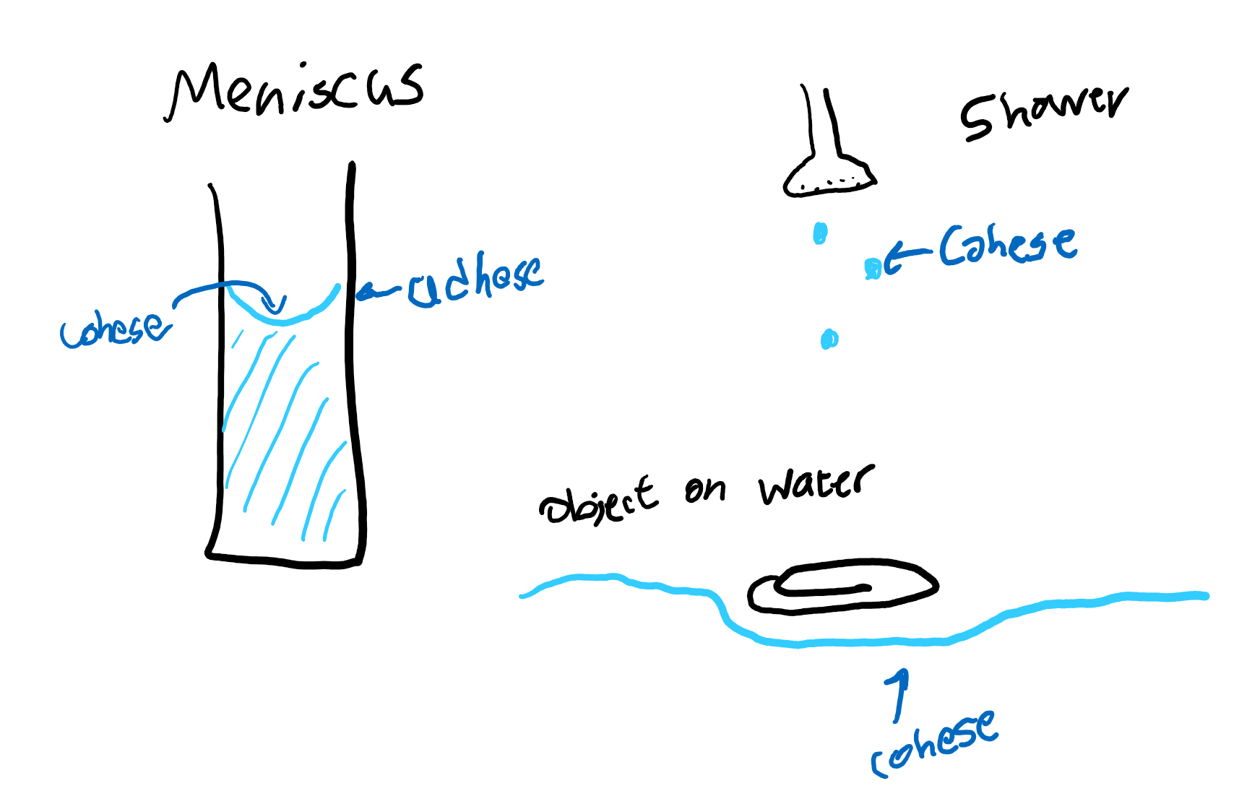
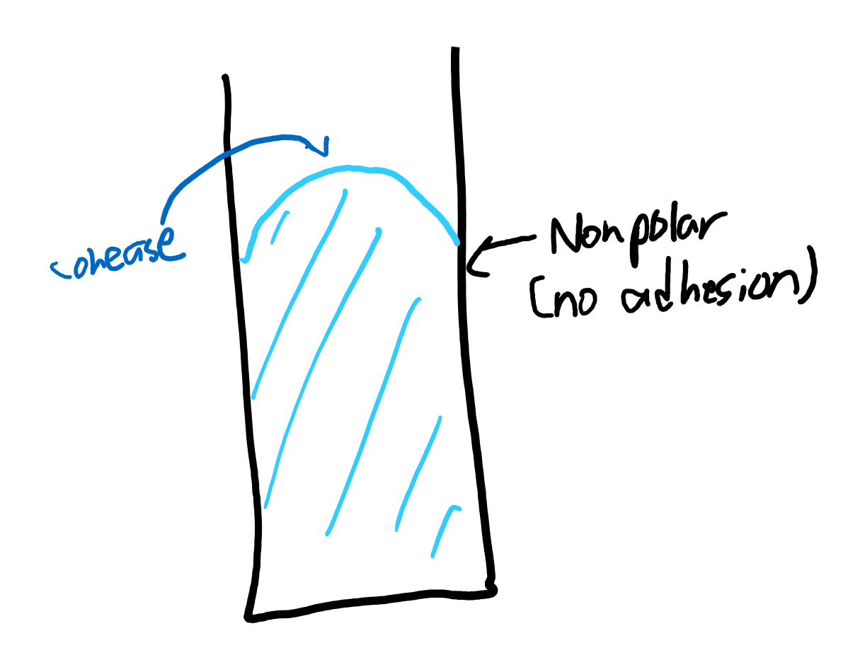
Different forms of tension

Slide 6
Non-Newtonian fluids

Slide 7
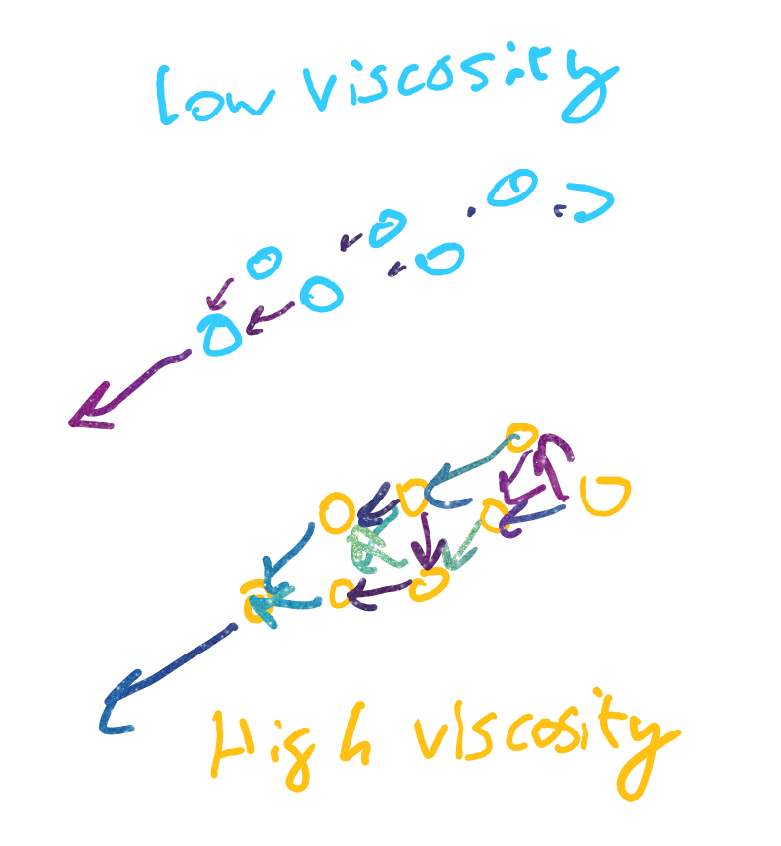
Viscosity?
The more “viscous” something is, the less it wants to flow. Like honey is super viscous; slow flow. Water is not very viscous; flows easily.
The higher the attraction between molecules, the more molecules are “pulled” when I pull one molecule, so the entire mix becomes harder to pull.

Slide 8
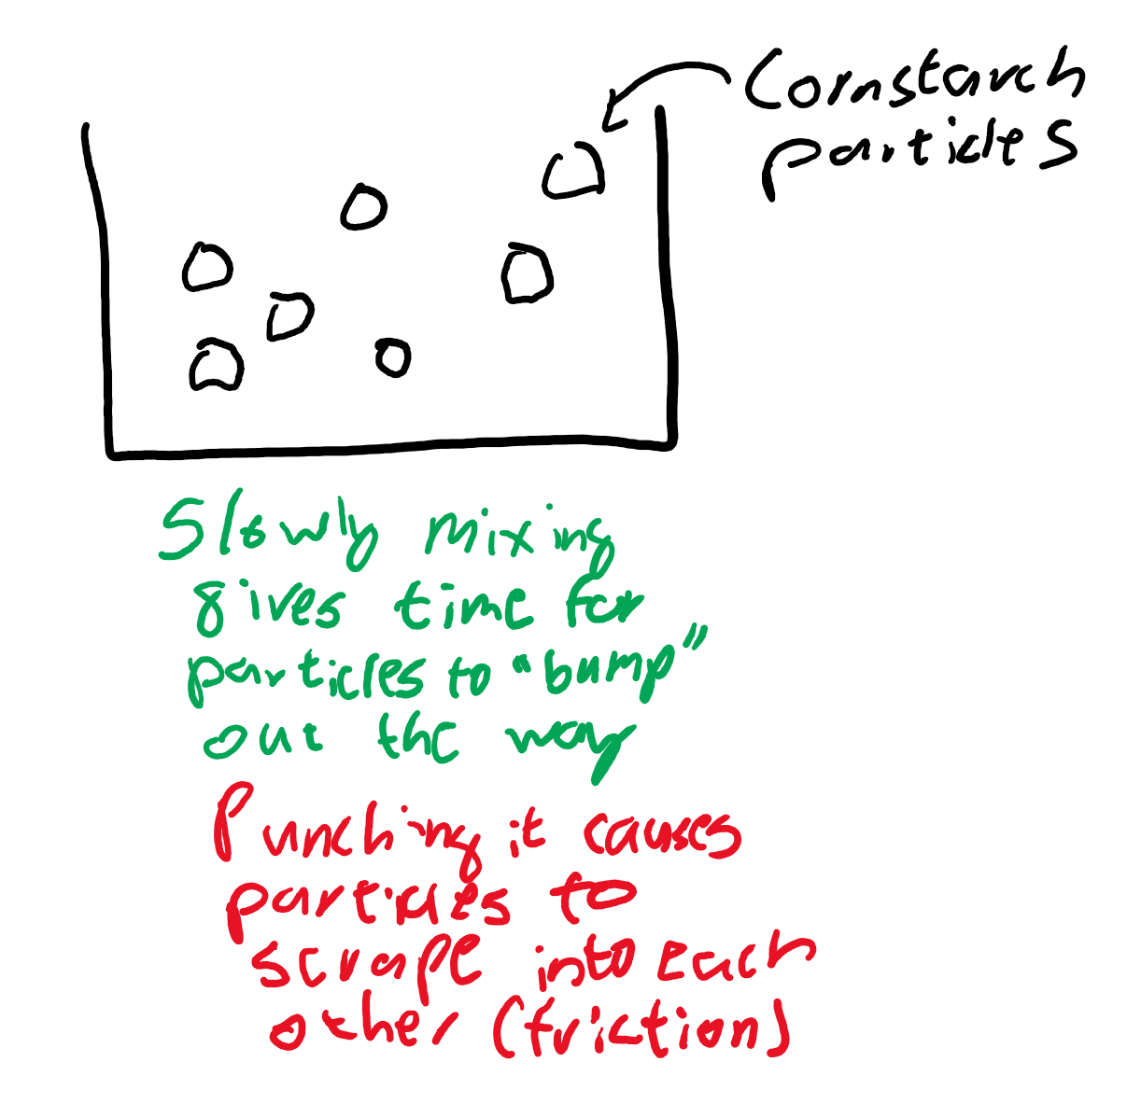
Newtonian fluids
External forces can’t change the viscosity of the fluid. Like water.
Few main types:
Shear thickening: when you apply a force, it becomes thicker (oobleck)
Shear thinning: when you apply a force, it becomes thinner (ketchup)
Thixotropic: becomes thinner as you apply a force for longer (peanut butter)

Slide 9
Conservation of angular momentum

Slide 10
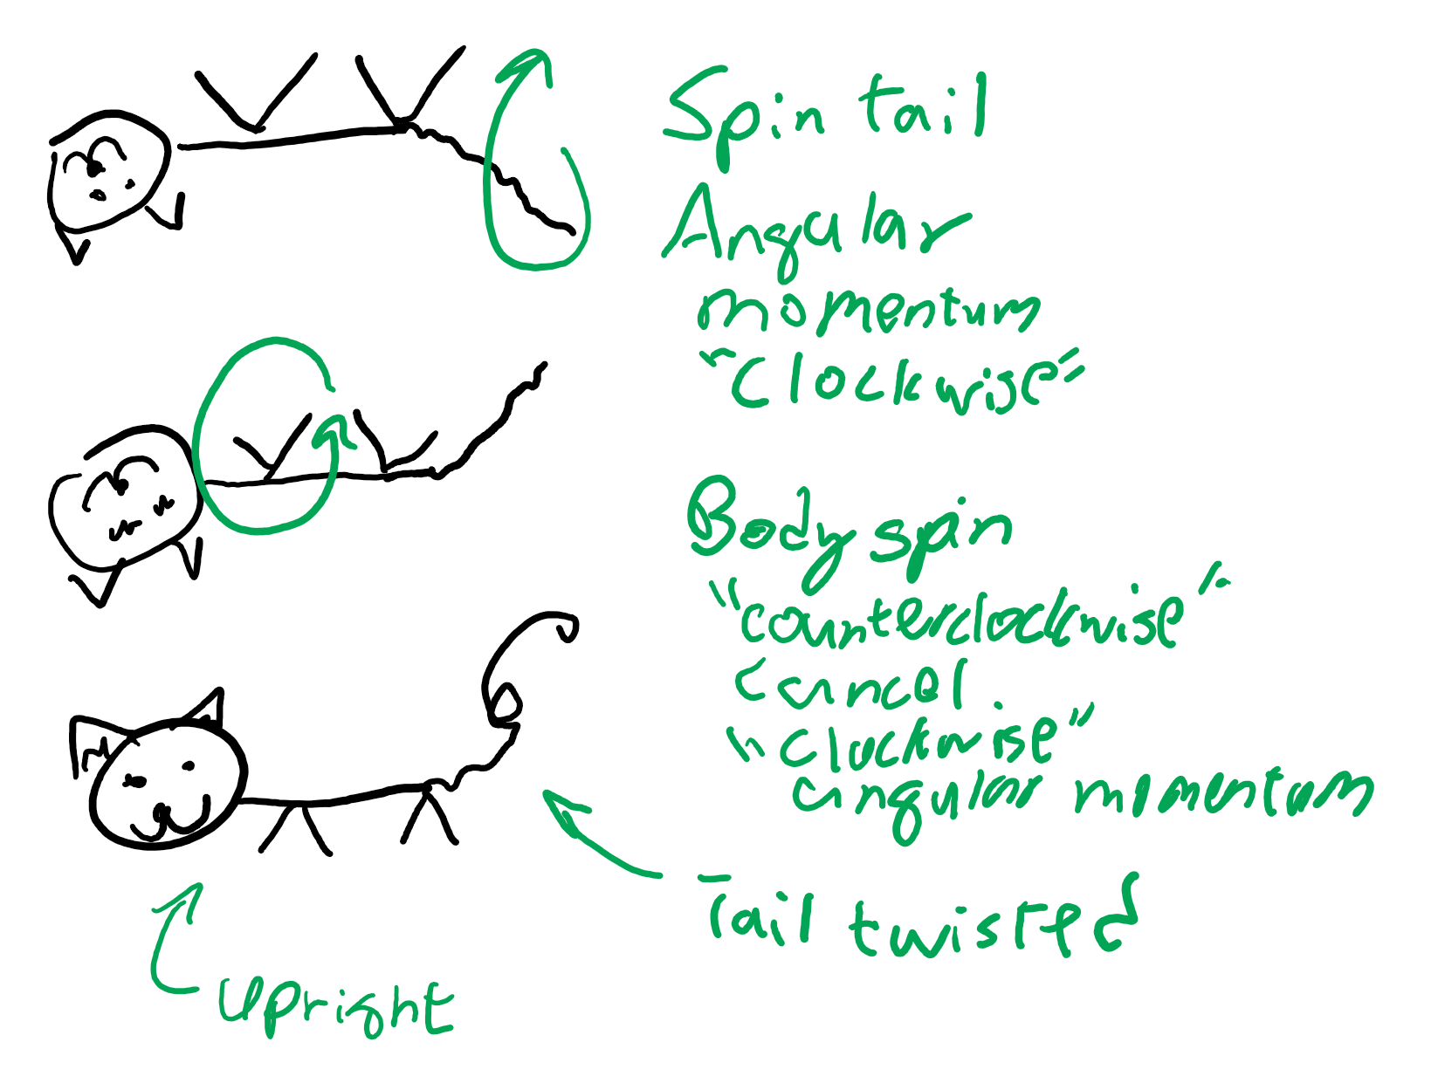
Cat spinny
Conservation of angular momentum says that if an object wasn’t spinning, it can’t start spinning unless a torque is applied. No torque is applied in free fall.
That means if one part has an angular momentum, another part is gonna have to cancel out that angular momentum by spinning the other direction.
The cat’s body and tail act as the two things that cancel each others’ angular momentum out.
https://www.youtube.com/watch?v=RtWbpyjJqrU

Slide 11
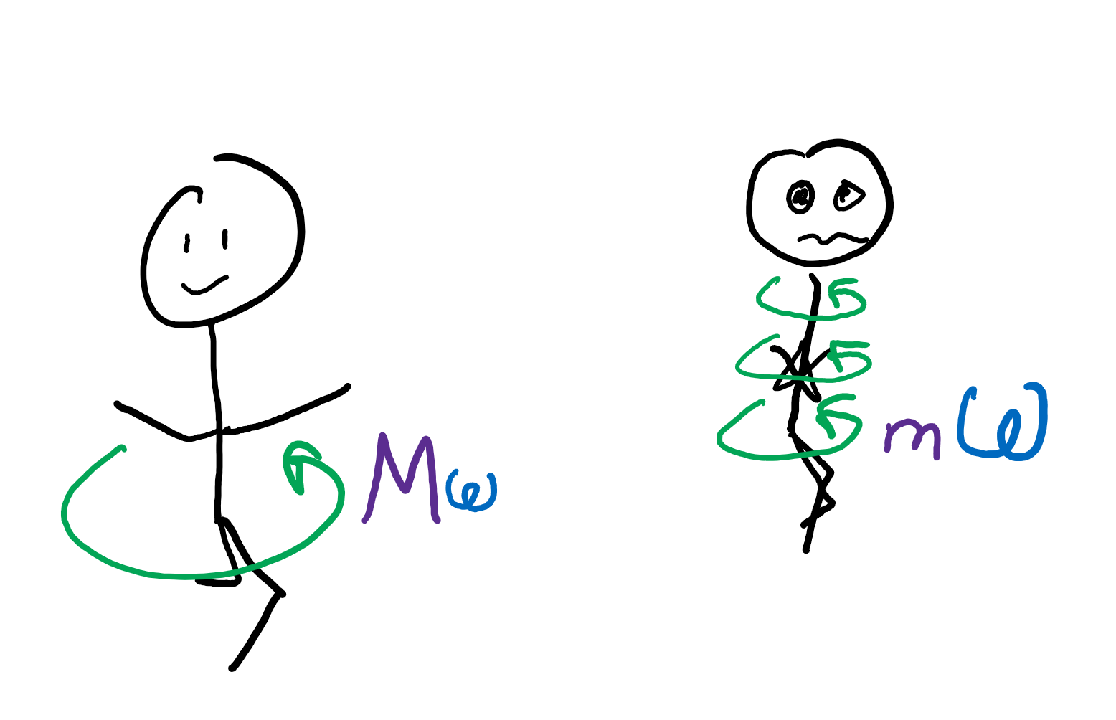
People spinny
Let’s say we had an initial angular momentum when we were going into a spin.
Recall moment of inertia is lower when our mass is closer together.
If we pull our arms closer together, what happens to moment of inertia?
If angular momentum is conserved, what happens to angular velocity?

Slide 12
Projectile motion

Slide 13
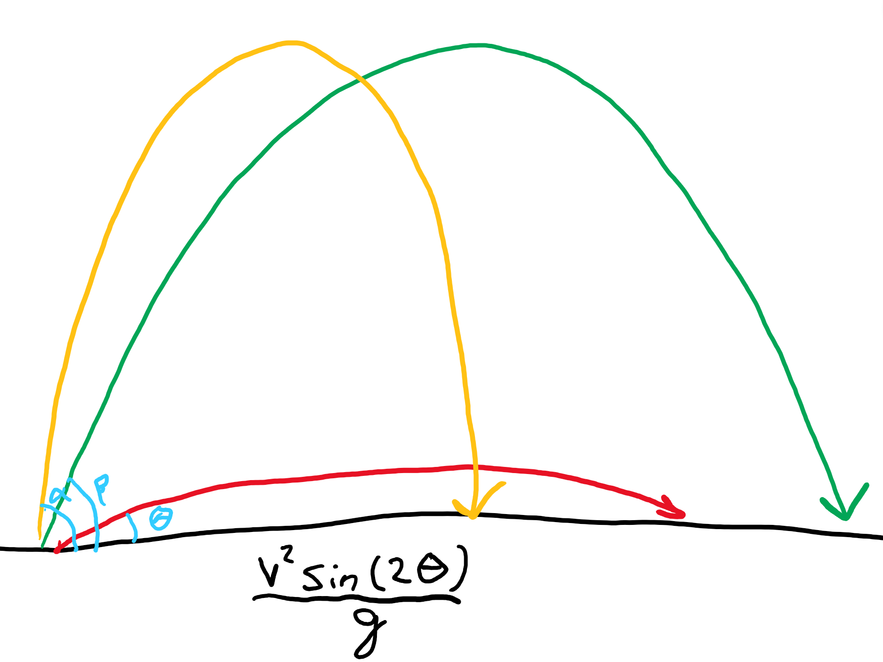
Given an initial velocity v. . .
Different angles will give different distances traveled, even if the same initial velocity is applied.
A 45 degree angle is optimal for the longest distance! (That’s the angle made when you fold the corner of a paper in half.)
Why? Gravity pulls down very quickly if you shoot at a flat angle. If you shoot too much upward, the ball isn’t “pushed” to the side enough, so won’t travel far.

Slide 14
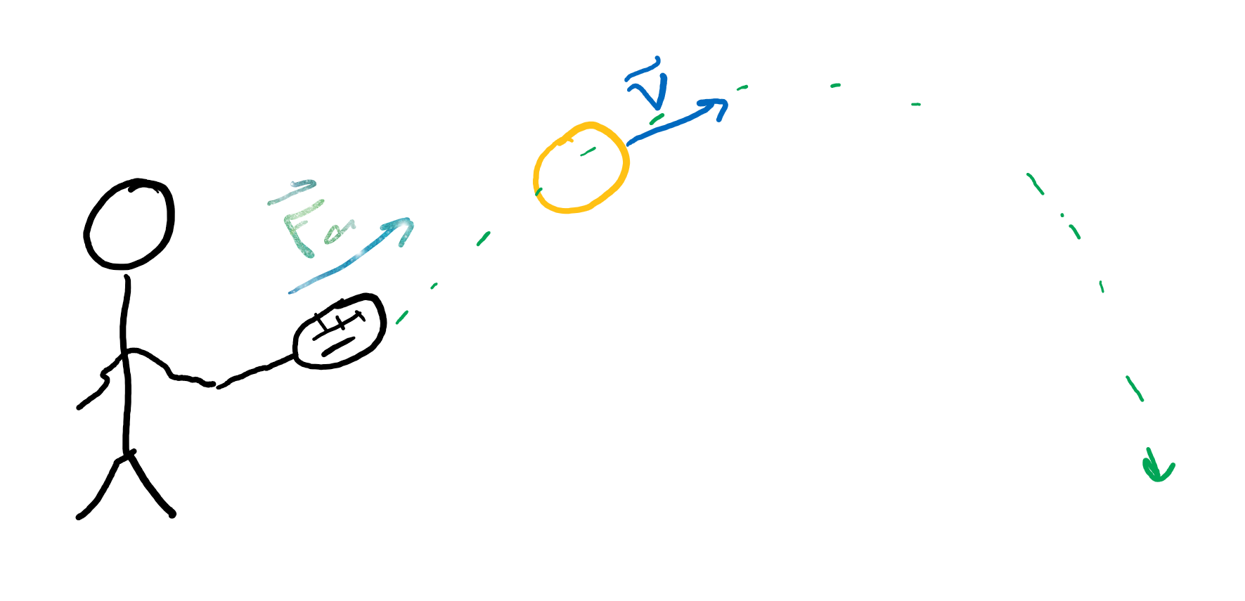
Generating initial velocity v. . .
What’s the relation between force and momentum?
If we apply the same force for longer, what happens to the momentum?
What’s the relation between momentum and velocity?
Velocity and distance?
So if a tennis player has a longer period of contact with the ball, how does that affect the distance the ball travels?

Slide 15
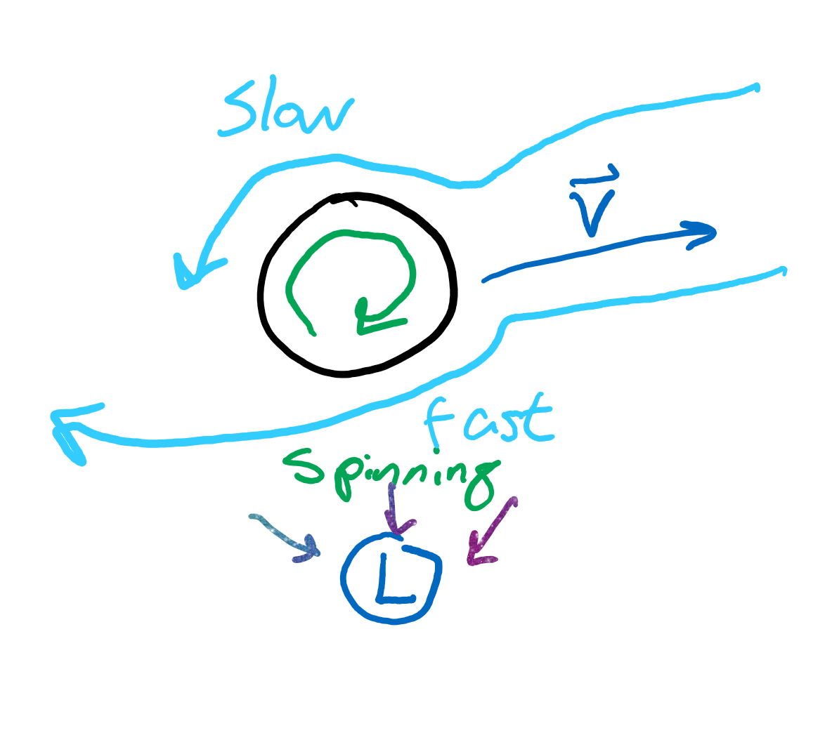
Spin?
Spinning in different directions cause weird forces to act on the ball.
Topspin causes it to be pulled downward faster than you’d expect normally.
Backspin causes it to be pulled slightly upward (lift).

Slide 16
Natural disasters

Slide 17
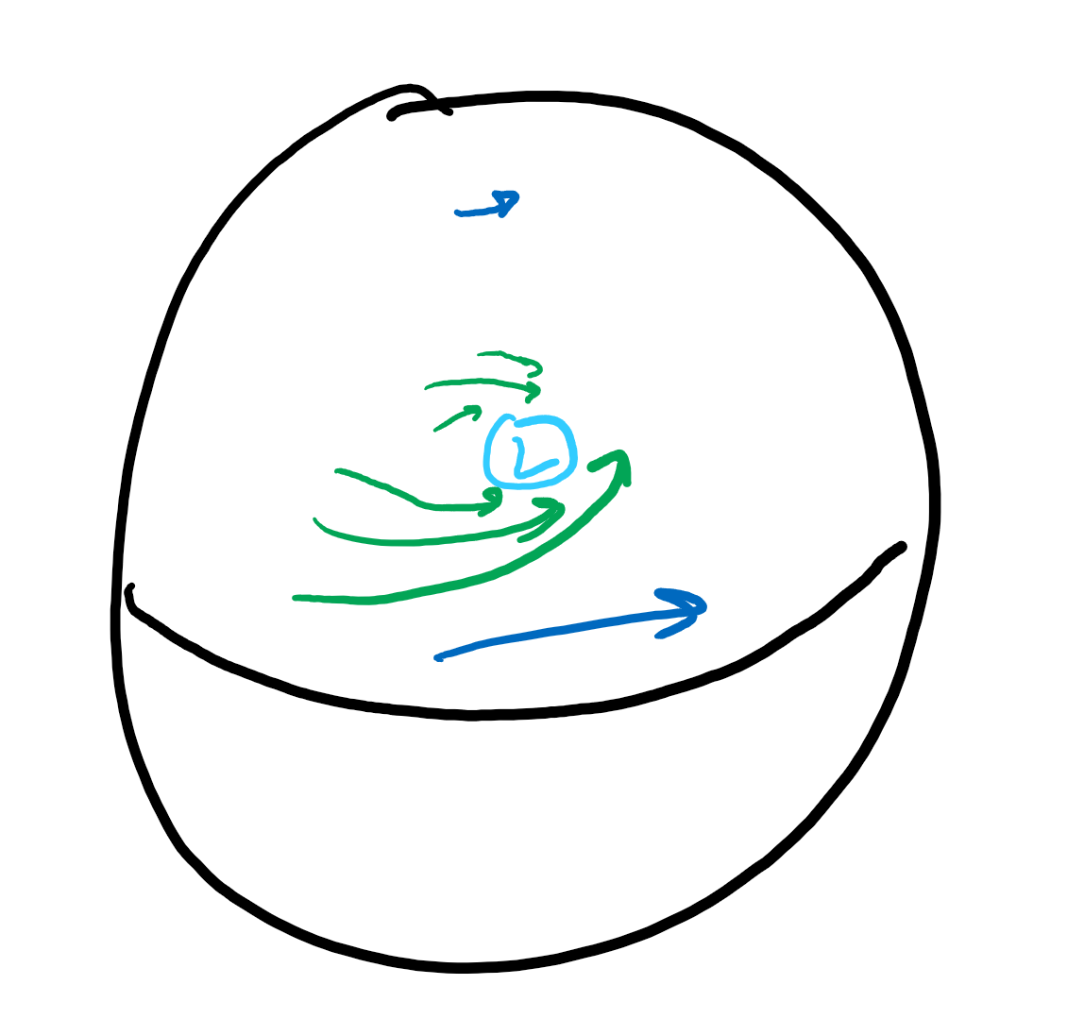
Hurricane
Coriolis force.
Low pressure area forms
Air swirls around that like water going into a drain
The direction of the “spin” is based on the coriolis force

Slide 18
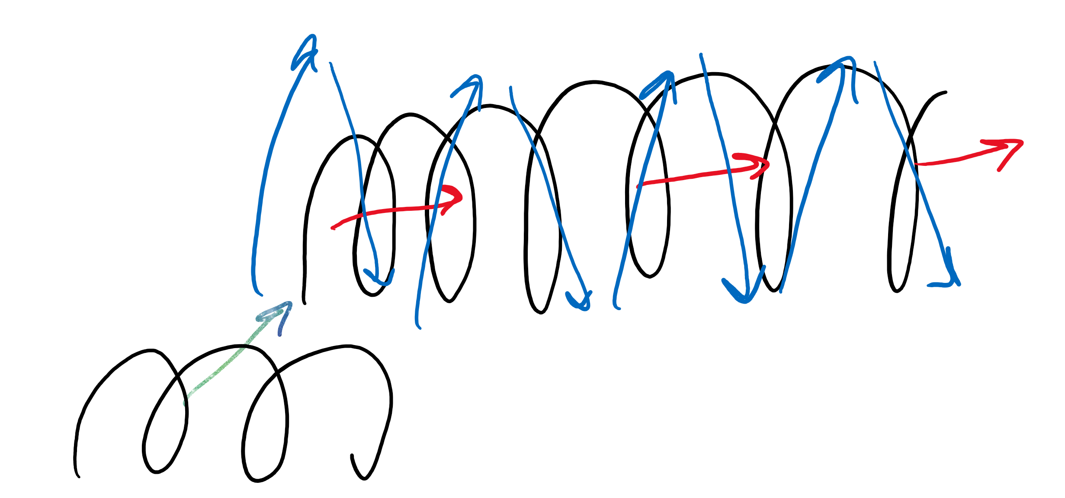
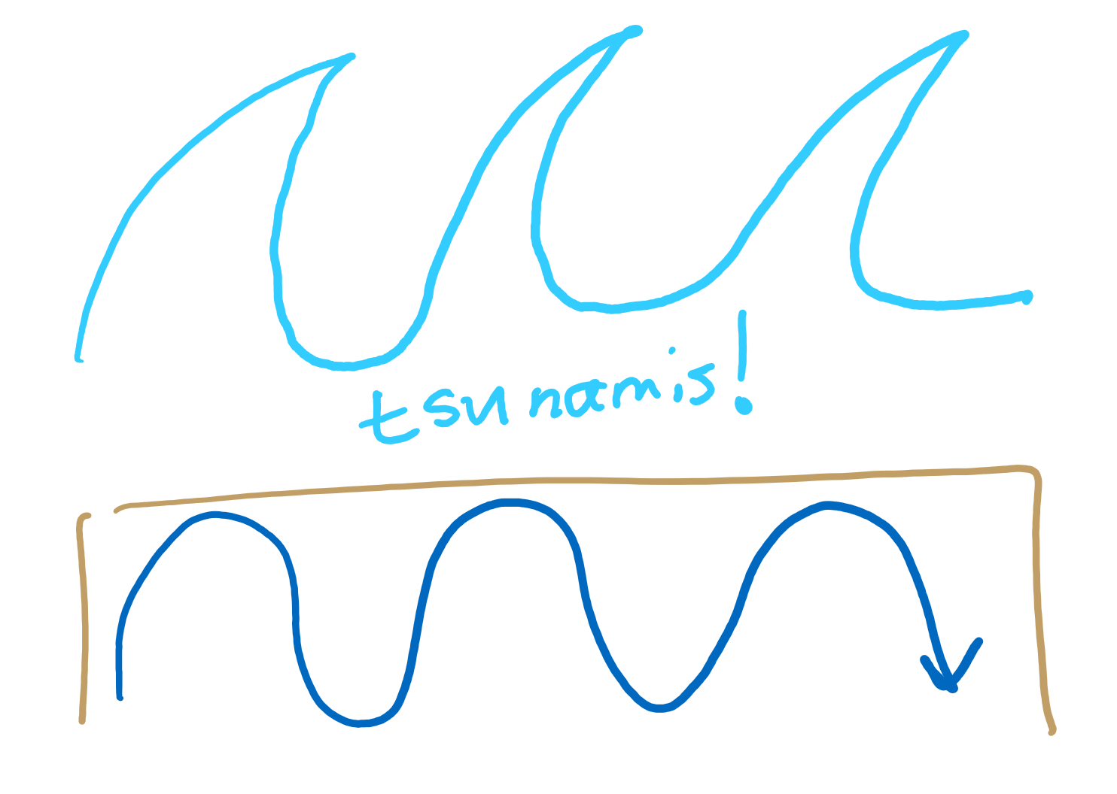
Earthquake/tsunami
Tectonic motion.
When tectonic plates move, they bump into each other, creating waves
Earthquakes have two main waves that cause the most damage, P (longitudinal) and S (transverse) waves
Tectonic motion under the ocean can disturb the water, generating tsunamis (result of the S waves)

Slide 19
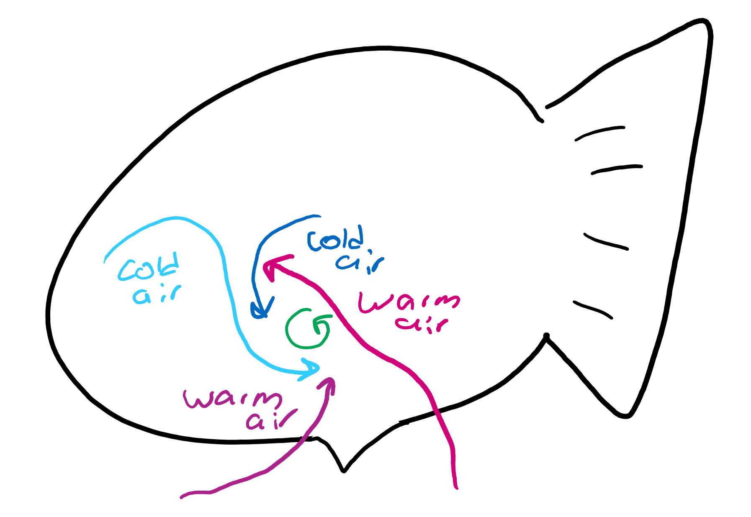
Tornado
Wind interaction.
Winds swirl around based on their motion patterns
Coriolis force has little to do with these because their radius is so small
Tornado alley
Westerlies (part of Mid-Latitude cell) interact with air moving north from the equator causes a lot of tornadoes in the region

Slide 20
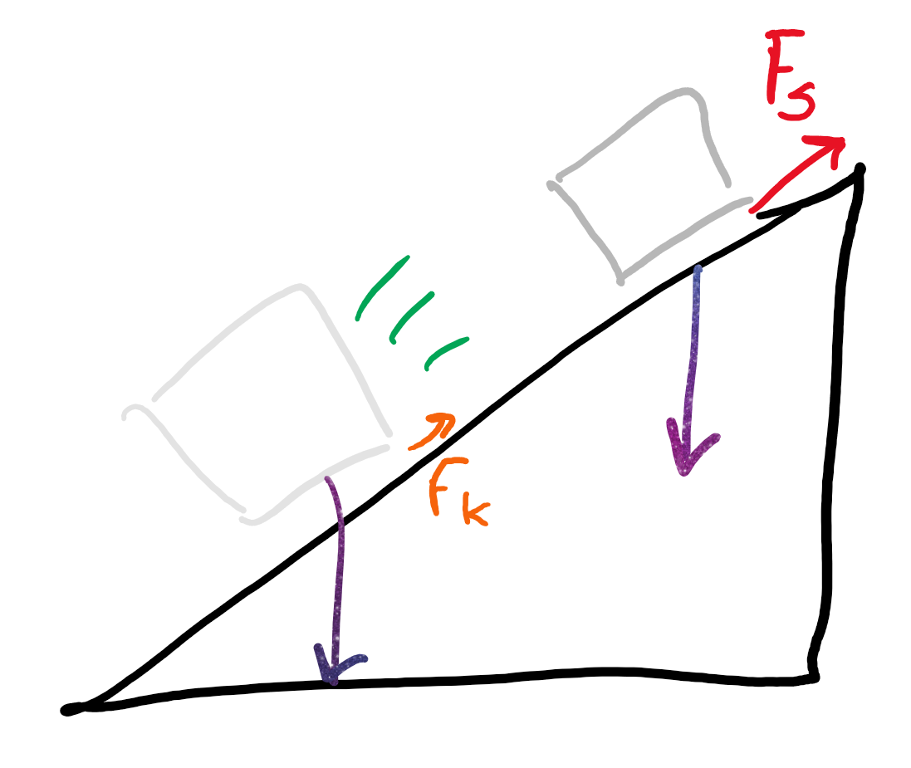
Landslide
Gravity!
Kinetic friction is less than static friction, so once something starts sliding, the friction force holding it from sliding is less
Once a landslide is set in motion, it’s hard to stop

Slide 21
Waves (preview)

Slide 22
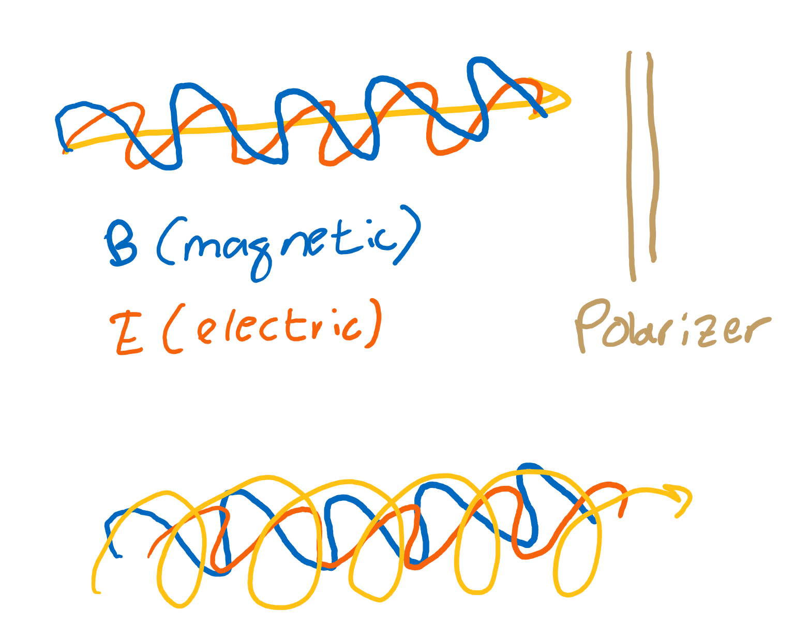
Light
Combination of two waves, electric and magnetic.
These come in and out of existence; aka, light makes its own medium; can travel without going through a medium.
All e/m waves travel at the same speed.
Polarization?

